Slide 1
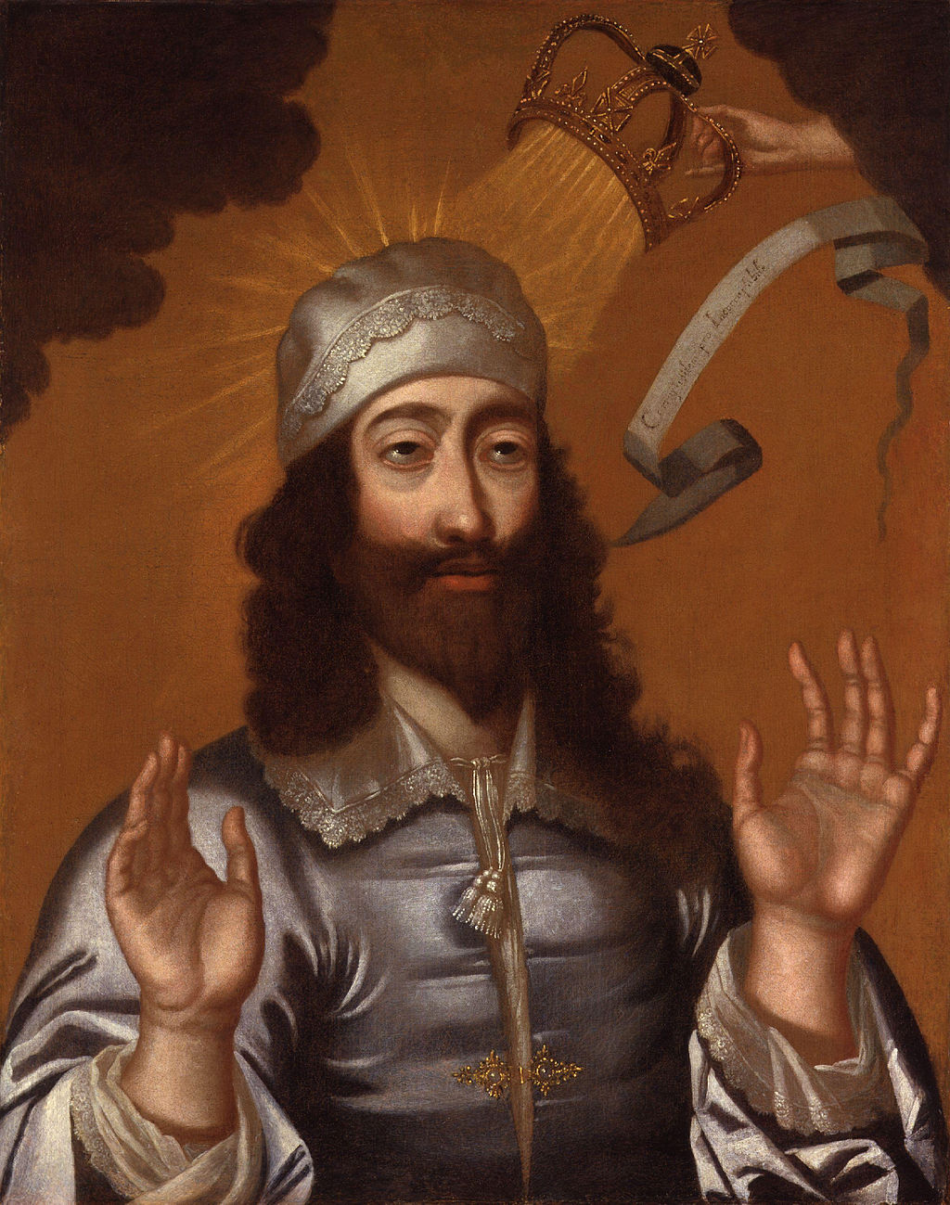
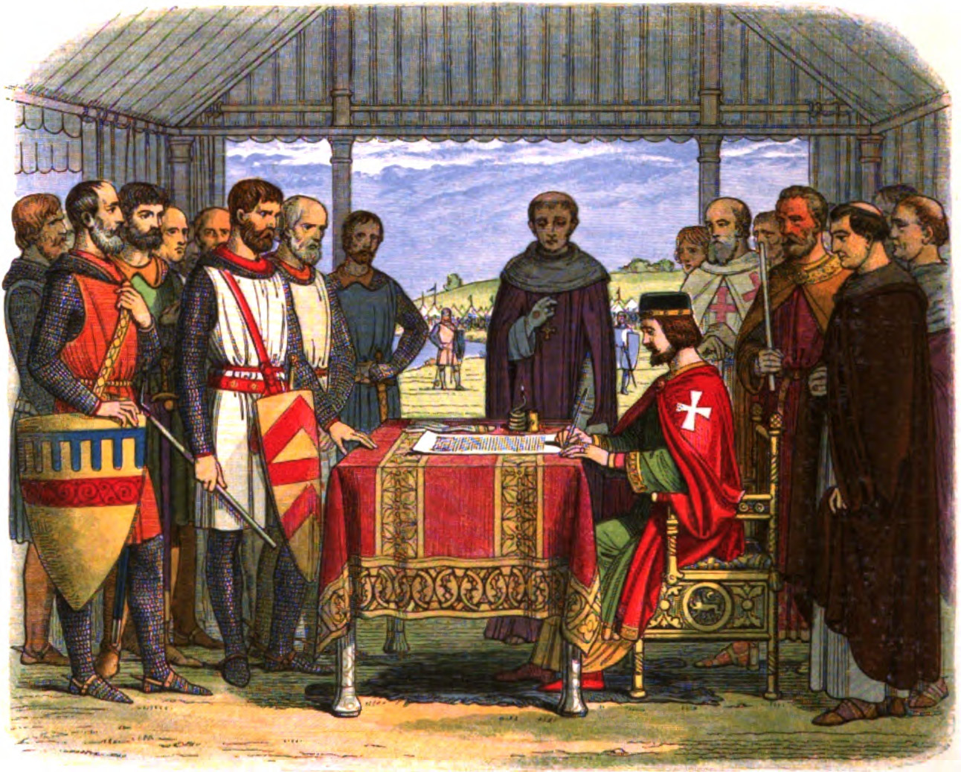
Governance, Power and Authority
TWO EARLY MODERN PARADIGMS

Slide 2
TRANSITIONS
ABSOLUTE MONARCHY➔
COMMONWEALTH (1649-1660)➔
RESTORATION OF MONARCHY (1660)

Slide 3
THE ROAD TO CIVIL WAR: a grappling for power
1629: CHARLES I dismisses Parliament, saying: “Princes are not bound to give account of their actions, but to God alone.”
1639: CHARLES I, in need of tax $$ for a war with Scotland, recalls Parliament but they wrangle and he dismisses them;
1640: the Long Parliament. Parliament under Cromwell passes laws that allow Parliament to be called without royal assent; taxation $$ denied;
1640-42: Charles increasingly unpopular, rebellions in Scotland and Ireland, Parliament gains power;
Summer 1642-47: Civil War;
1647-49: Charles imprisoned and tried;
Jan 1649: REGICIDE: Charles executed.

Slide 4
TWO PARADIGMS OF GOVERNANCE
DIVINE RIGHT
SOCIAL CONTRACT
Leader’s power derives from GOD;
The sovereign is ABOVE THE LAW
The sovereign GOVERNS OVER the people
The subject’s duty is to the sovereign
Rebellion is a SIN
(Queen Elizabeth I, Thomas Cranmer, Catherine Philips)
Leader’s power derives from the PEOPLE;
The sovereign is SUBJECT TO THE LAW
The sovereign GOVERNS ON BEHALF OF the people
The subject’s duty is to the law
Rebellion is the RIGHT and DUTY of the people
(John Milton)

Slide 5
A STRUGGLE TO CONTROL AND NARRATIVE
NARRATIVE—the stories we tell that explain our relationship to the world—shapes what we see as POSSIBLE;
HOW these positions are presented is as crucial as the content of these positions;
Our discipline is ATTUNED to the WAYS THAT IDEAS ARE COMMUNICATED
“…the change that counts in revolution takes place first in the imagination.”
“…symbolic and cultural acts have real political power.”
(Rebecca Solnit, Hope in the Dark)

Slide 6
POWER, AUTHORITY, LEGITIMACY
POWER: physical might, the ability to exert one's will over others;
AUTHORITY: the right, given by law, to exert one's will;
LEGITIMACY: a recognition on the part of subjects that the exercise of power is reasonable and just.

Slide 7
DIVINE RIGHT
the principle that the hereditary monarch is God’s representative on Earth and that, as such, has absolute authority over all his subjects.
The fact that the individual monarch was born in natural succession is proof that the monarch is legitimized by divine right.

Slide 8
NARRATIVE #1: BODY POLITIC
a conceptual and political model that figured the state as analogous to a HUMAN BODY
each person, position, social role was equivalent to a part of the body:
soldiers= arms;
farmers=belly;
king=HEAD.

Slide 9
DISOBEDIENCE=ABSURDITY The Power of the Body Politic Metaphor
God forbid. For first what a perilous thing were it to commit unto the subjects the judgment, which prince is wise and godly and his government good, and which is otherwise; as though the foot must judge the head; an enterprise very heinous, and must needs breed rebellion.
(Thomas Cranmer, The First Part of An Homily Against Disobedience and Wilful Rebellion)

Slide 10
NARRATIVE #2: DOCTRINE OF OBEDIENCE
Subjects must submit to the rule of the monarch under all circumstances, even if the monarch is cruel, arbitrary or, indeed, insane.
Consequences of violating the Doctrine:
TOTAL SOCIAL BREAKDOWN;
Descent into ABSURDITY;
Impossibility of creating or maintaining MEANING

Slide 11
NARRATIVE #3: NATURALIZING MONARCHY
But clouds of joys untried do cloak aspiring minds, Which turn to rain of late repent by changed course of winds. The top of hope supposed the root upreared shall be, And fruitless all their grafted guile, as shortly ye shall see.
(Elizabeth I, “The Doubt”)
NATURALIZE: to frame a social process or condition as a product of natural forces and therefore as inevitable and immutable as a force of nature.

Slide 12
UNNATURAL REBELLION
… so here is a cause
That will excuse the breach of nature’s laws,
Silence were now a sin... (5-7)
The dying lion kicked by every ass (10)
Take not our reason with our king away (25)
(Catherine Philips, “Upon the Double Murder of King Charles)
To rebel = to BE UNNATURAL or even INHUMAN and to OVERTURN the natural ORDER of the world.

Slide 13
NARRATIVE #4: REBELLION AS CONTAGION AND DISEASE
“rebels do not only themselves leave all works necessary to be done … [but] do compel others that would gladly be well occupied to do the same” (165)
“as rebels are many in number, so doth their wickedness and damnation spread itself unto many” (166)
“coveting or desiring of all other men’s wives, houses, lands, goods, and servants in rebels, who by their wills would leave unto no man anything of his own?” (166)
(Thomas Cranmer)
The BODY POLITIC preys upon ITSELF.

Slide 14
NARRATIVE #5: PRIVATE SIN CONTAMINATES ALL
“all sins possible to be committed against God or man be contained in rebellion; which sins, if a man list to name them by the accustomed names of the seven capital or deadly sins, as pride, envy, wrath, covetousness, sloth, gluttony, and lechery, he shall find them all in rebellion, and amongst rebels” (Cranmer 166).
“No bounds will hold those who at scepters fly” (Philips 28).
What is the effect of framing rebellion as a private sin of individual corruption?
(Consider the critique of the “lone wolf” characterization of mass shooters)

Slide 15
REBELLION: CHIEF AMONG SINS
How horrible a sin against God and man rebellion is, cannot possibly be expressed according unto the greatness thereof. For he that nameth rebellion nameth not a singular or one only sin, as is theft, robbery, murder, and such like; but he nameth the whole puddle and sink of all sins against God and man; against his prince, his country, his countrymen, his parents, his children, his kinsfolks, his friends, and against all men universally; all sins, I say, against God and all men heaped together nameth he that nameth rebellion.
(Thomas Cranmer, The First Part of An Homily Against Disobedience and Wilful Rebellion)

Slide 16
HOMEWORK FOR NEXT DAY: MILTON’S REBUTTAL
How does John Milton address these claims and narratives in the excerpts from The Tenure of Kings and Magistrates?
Does he offer a COUNTER-NARRATIVE?
What images or metaphors or strategies does he use to make his case?

Slide 17
CHURCH and STATE
1535: The Act of Supremacy/Protestant Reformation (Henry VIII)
Est. the King of England as the Head of the Anglican Church
1563: 39 Articles of Religion (Elizabeth I)
Charts a “moderate” path between Continental Catholicism and “radical” Continental Protestantism
1649: Arraignment of Charles I
Parliament argued the King was SUBJECT to the LAW;
Charles argued that the King WAS the Law and therefore could not be tried by the people.

Slide 18
HUMAN DUALITY
Taken together, the two kinds of law reflect the DUAL NATURE of humanity:
RATIONAL and naturally capable of goodness:
“RIGHT REASON”: the natural tendency to know and to do good.
WILD BEAST: Fallen and base and likely to turn away from reason
APPETITE: driven by needs and self-interest that require firm controls

Slide 19
REBELLION AGAINST FATHERS
“For first, the rebels do not only dishonour their prince, the parent of their country, but also do dishonor and shame their natural parents…” (Cranmer, “Disobedience” 694).
“… the dishonor done by rebels unto God’s holy name by their breaking of the oath made to their prince…” (693).
What is the effect or purpose of this equivalence?

